Slide 1
RPKI in the neighborhood
Agustín Tudurí
Diego Guglielmi
Jesús Beltrán
Sofía Silva Berenguer

Slide 2
Goals
Module 1: Get the list of BGP neighbors and the list of announced prefixes for an ASN or set of ASNs ✔️
Module 2: Get the level of RPKI deployment for an ASN or set of ASNs ✔️
Module 3: Visualize the neighborhood of an ASN showing the level of RPKI deployment of each ASN in the diagram. ✔️

Slide 3
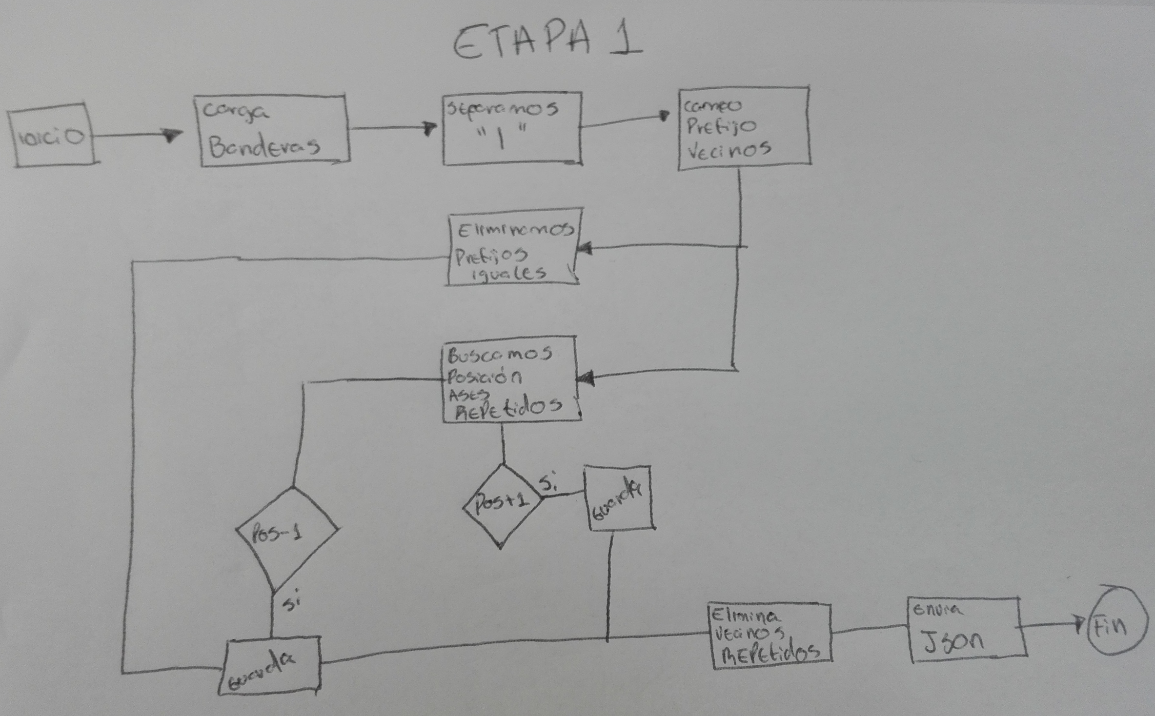
Module 1

Slide 4
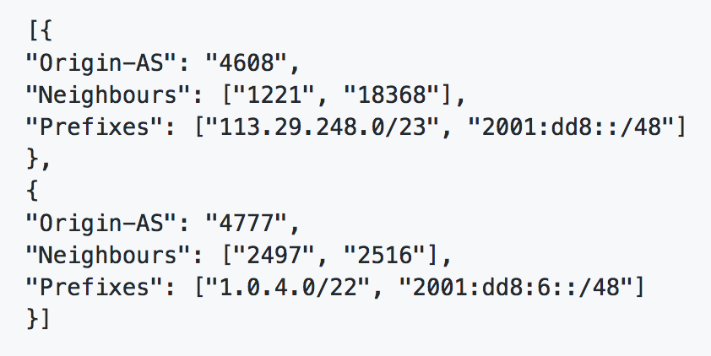
Module 1
Challenges:
Get familiar with format of BGPRIB file
Take into account BGP prepends so that an ASN is not considered to be neighbor of itself
Take into account that the ASN of interest can appear at the beginning or at the end of an AS path so it may not have a neighbor to its left or to its right

Slide 5
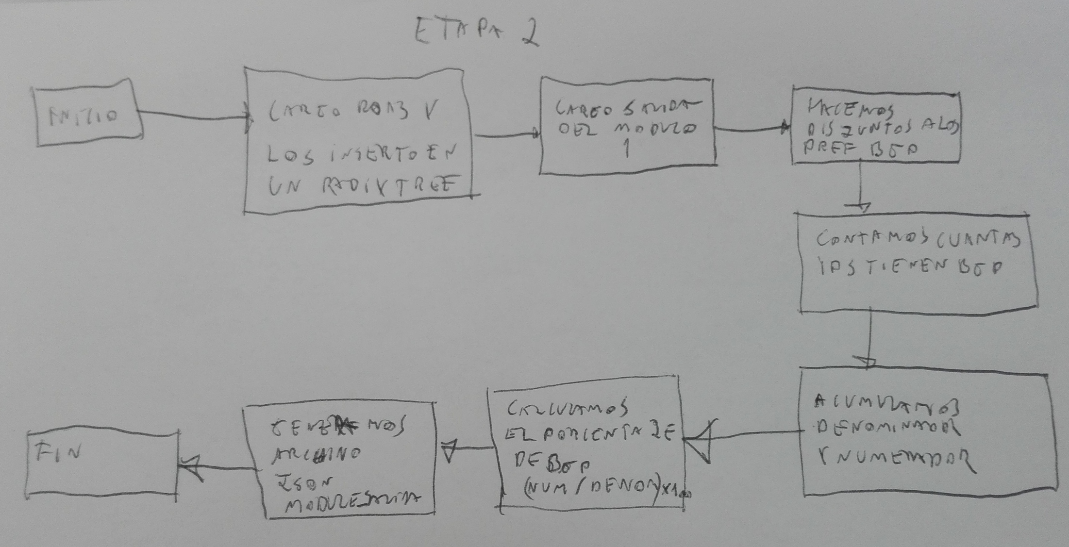
Module 2

Slide 6
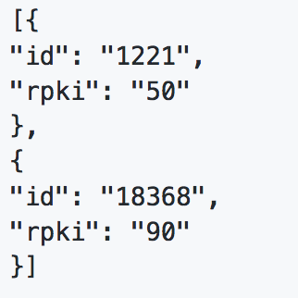
Module 2
Challenges:
Insert ROAs data into Radix tree in order to allow for covering/covered prefixes search
Take into account BGP deaggregation (Compact list of announced prefixes)
Take into account overlapping ROAs (Compact list of prefixes covered by ROAs)
Compute AS coverage as weighted average of prefixes coverage

Slide 7
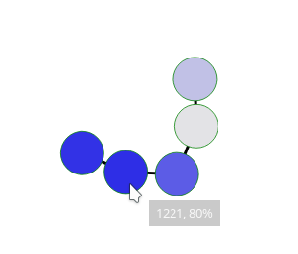
MODULE 3
Challenges:
Understand visualization tool (D3.js)
Adapt JSON format to tool requirements
Nodes colors based on level of RPKI deployment

Slide 8
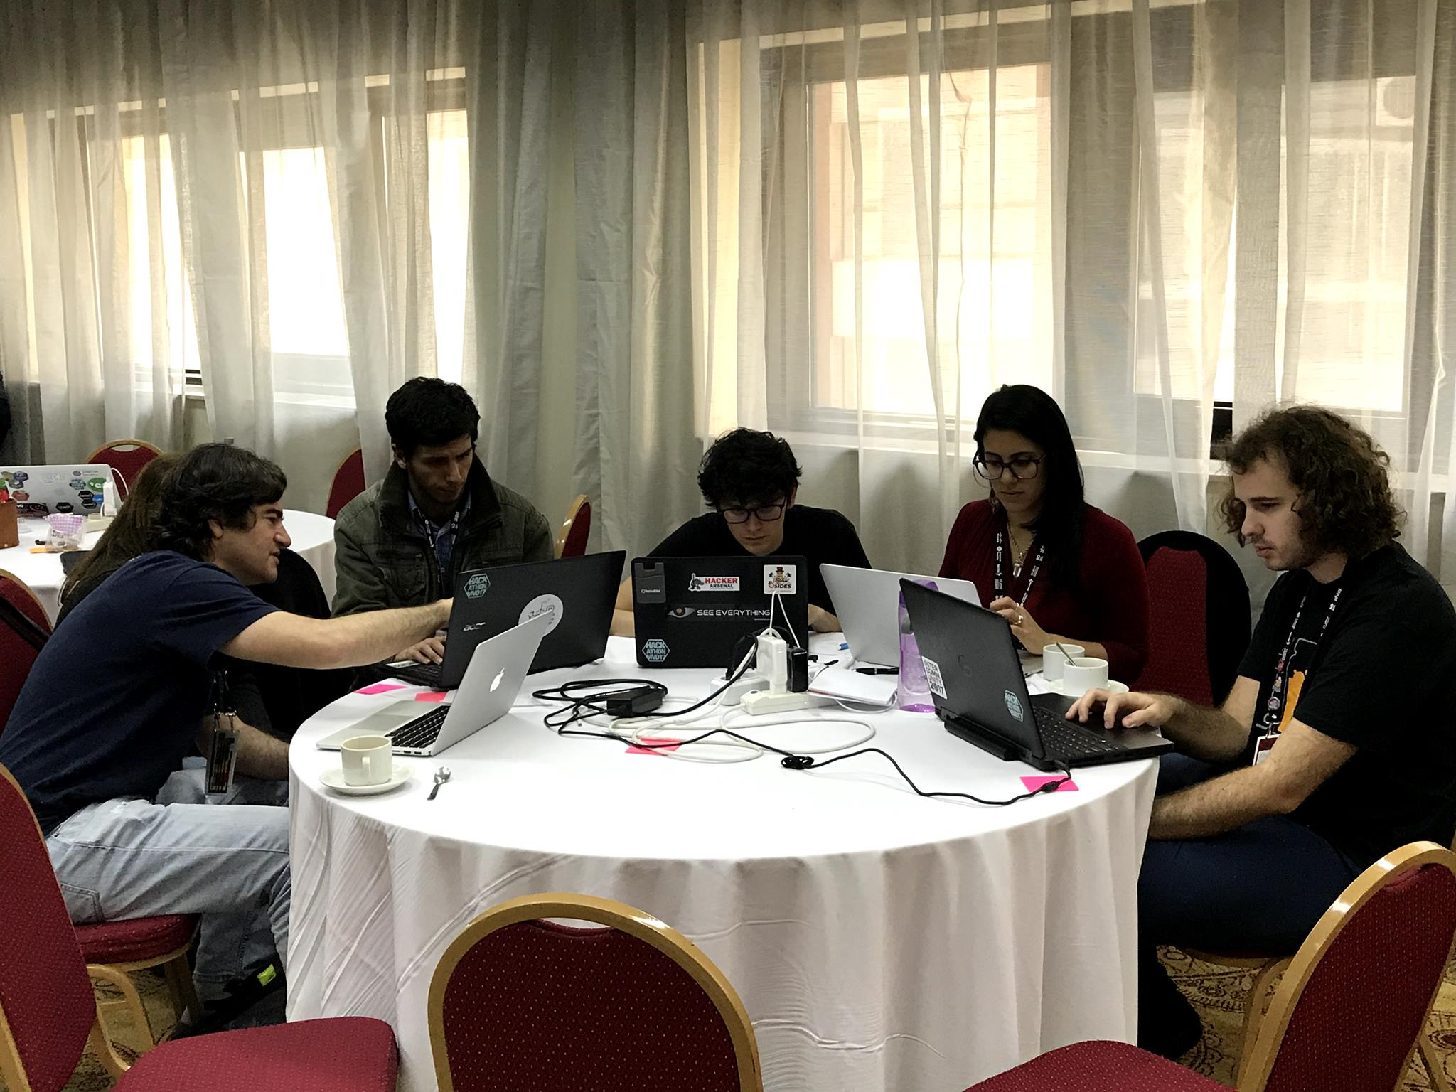
We WORKED REALLY Hard ☺

